Slide 1
UK Industrial Strategy:
Progressing Rural Contributions
27 March 2019
Industrial Strategies and Rural Productivity
Matthew Gorton, Pattanapong Tiwasing, Jeremy Phillipson, Sara Maioli and Robert Newbery

Slide 2
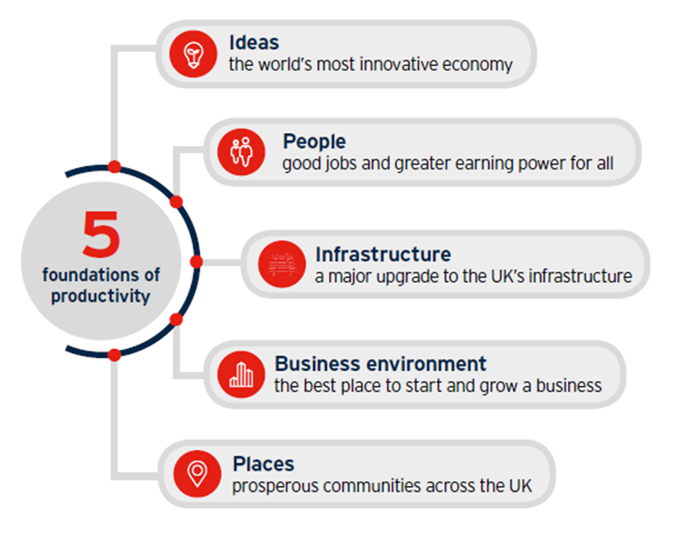
Five Foundations of the Industrial Strategy
Based on analysis of the Longitudinal Small Business Survey (LSBS), what can we say about each pillar in rural areas? Evidence to inform local industrial and economic strategies.

Slide 3
Ideas
Similar percentage of rural and urban firms (30.2% vs. 30.2%) introduced new or improved services in the last three years.
Rural firms are more likely than urban firms to have introduced new or improved goods (18.8% vs. 16.5%).
Disruptive innovations at heart of Industrial Strategy - goods or services which are new to the market. Across England - no significant differences between rural and urban firms.
However, significantly fewer enterprises in Mainly Rural Local Authority Districts report ‘new to the world’ innovation in the form of goods or services new to the market.
Innovation opportunities and challenges also vary regionally.

Slide 4
Ideas (2)
Complex relationship between innovation and productivity.
No statistically significant relationship between new product development and productivity (most new products fail, even successful ones at first often inefficient).
Positive relationship between process innovation and productivity.
Matching analysis: rural firms as innovative (product and process) as their urban counterparts.
Notes:
Rural areas can be crucibles of innovation.

Slide 5
People
Overall, rural population face poorer choice of jobs, and get paid less for jobs requiring fewer work place skills. Less on the job training.
Many rural firms who wish to create high skilled employment opportunities find recruitment of skilled staff a problem. Issue for a third England’s rural small firms who employ staff.
Significantly fewer rural employing firms are planning to improve their leadership capabilities (39% compared to 47%) or to introduce new working practices (44% compared to 52%), compared with their urban counterparts.
About 70% of both rural and urban firms with employees plan to increase the skills of their workforce.
Notes:
General picture

Slide 6
People (2)
In terms of productivity, the business networks that people belong to matter.
Firms in the Northern Powerhouse (NP) and Midlands Engine (ME) weaker overall in terms of private-sector business networks and co-operation.
After controlling for other factors (sector, age, location) women owned businesses appear less productive. Likely to be multiple reasons for this.
Some business problems reported more often by women (e.g. late payment).

Slide 7
Infrastructure
Controlling for different locations (LEPs), broadband speed positively contributes to productivity in business services.
Firms who have their own websites are more productive (those using a third party website to promote or sell goods/services tend to have lower productivity).
Firms who are unable to access broadband speeds less than 2Mbit/s (5Mbit/s and 10Mbits) are negatively associated with sales growth.
In 2015, York and North Yorkshire LEP has the highest average mean % premises unable to receive 2Mbit/s, followed by The Marches and Greater Lincolnshire LEP (Ofcom, 2018).
Notes:
Front

Slide 8
Business Environment
Consider in terms of operating problems faced:
First level problems:
Regulations/red tape, Competition in the market, Tax/NI/Rates and Late payments.
Often difficult for regional / rural development officers to control / influence.
Second level problems:
Between 10 and 20% rural firms identified: Staff recruitment and skills, Obtaining finance, and Availability of Premises to start-up or grow as major obstacles.
Greater scope for regional / rural development policy impacts.
Premises and rural enterprise hubs.

Slide 9
Business Environment (2)
Regional variations in problems encountered
Obstacles to finance a greater problem for rural firms in the SW and NE. 40% rural and 22% of urban businesses in NE England citing this barrier.
Exporting
Higher proportion of rural (6.6%) than urban (5.1%) firms in England exported goods and services (7.9% of rural compared to 7.1% of urban firms).
However, rural firms less likely than urban exporters to make overseas sales every year or plan to increase the levels of exports in future.
Considerable export potential unrealised.

Slide 10
Places
SMEs in London and South East (LSE) are, overall, significantly more productive than those in the NP and ME.
Partly this is due to sectoral differences across regions but not entirely (matching analysis).
Most deprived localities (based on index of multiple deprivation) associated with lower productivity.
In North and Midlands rural firms just as productive as urban counterparts. Question city focus of NP and ME initiatives.

Slide 11
Conclusions
Regarding raising productivity
Greater focus on process innovation, facilitation of private sector business networks, broadband, and digital skills.
Gender requires greater attention.
Urban bias in regional development / innovation initiatives unwarranted.

Slide 12
Conclusions
Key rural challenges
Premises, skills training, access to finance, support for disruptive innovations, realising export potential. Importance of challenges varies regionally and locally.
REUK Team
Committed to further analysis that can inform evidence base of Industrial Strategy, nationally and locally. For instance, particular geographical / sector compositions.

